Slide 1
Systems Analysis and Design Chapter 6. Logic Modeling

Slide 2
Overview
1
Introduction to Logic Modelling
2
Structured English
3
Decision Table
4
Decision Tree

Slide 3
Specifying Processing Logic
Data flow diagrams (DFDs) prove very effective tools for identifying processes and data flow within an information system
BUT DFDs do NOT tell us :
the processing logic inside each process
when processes run
We need to specify detailed instructions for the elementary or primitive DFD processes
elementary process descriptions
When you analyze a functional primitive, you break the processing steps down into smaller units in a process called modular design.
Notes:
Do not to confuse logic models with logical system descriptions.
A logic model is a model or specification of the processing logic for a primitive DVD process.

Slide 4
DFD Levels of Abstraction
Context
Level 0
Level 1
Level 2
Level n
Agent
2
2.2
2.2.2
1
Process
2.1
2.2.1
Elementary Process Description
(Logic Modelling)
Decision tables
Decision trees
Structured
English
Sub-Process
Sub-Sub-Process
0
2
2.2
2.2.2
System
Process
Sub-Process
Sub-Sub-Process
3
2.3
2.2.3
Process
Sub-Process
Sub-Sub-Process
Agent
An elementary process is a DFD process at its lowest level where ALL of its data flows have been revealed. A description of its logic is then required for that process.
See : Lejk, M., and Deeks, D. (2002). An Introduction to Systems Analysis Techniques. 2nd Edition, PP 67, Pearson Education, ISBN: 0201797135.
Notes:
Logic Model is when you can’t further break down the process.
I.e. tell you what to do (how to calculate pay/discount/fees/etc..)

Slide 5
Logic Modelling
Logic modelling is a technique for specifying and documenting the processing logic of the elementary processes within a logical DFD
A logic model should be equally effective for communicating with users and programmers
Users must verify business accuracy of the logic
Programmers must be able to implement the business logic in any given programming language
The logic model MUST NOT be programming language specific

Slide 6
Logic Modelling
Deliverables and Outcomes
Structured English
Decision Tables
Decision Trees
Notes:
Others (but not covered):
State-transition diagrams
Sequence diagrams
Activity diagrams

Slide 7
1. STRUCTURED ENGLISH
SE is a language and syntax based on the relative strengths of structured programming and natural English for specifying the processing logic of elementary DFD processes
SE borrows logical constructs of structured programming to overcome the lack of structure & precision in the English language
SE is NOT pseudocode because it does NOT concern itself with programming-specific issues
Declarations
Initialisation
Linking
Technical/implementation issues
https://www.youtube.com/watch?v=phTgadEg6QU&t=58s

Slide 8
Logical Constructs in Structured English
Recall from any Programming lectures that ALL logic can be expressed by using 3 basic constructs :
Sequence
Selection
Iteration

Slide 9
Sequence Constructs
A sequence construct is simply an ordered list of one or more actions or events
In SE it is a sequence of simple, declarative sentences
Compound sentences are discouraged as they frequently create uncertainty
Use strong action verbs : GET, FIND, CREATE, ADD, DELETE, SORT etc
Example
Multiply Price by Quantity_Sold giving Net_Price
Multiply Net_Price by 0.175 giving VAT
Add VAT to Net_Price giving Gross_Price
OR
Calculate Net_Price = Price * Quantity_Sold
Calculate VAT = Net_Price * 0.175
Calculate Gross_Price = Net_Price + VAT

Slide 10
Selection Constructs
A selection construct (a.k.a conditional or decision constructs) indicates that a process must perform different steps under well-specified conditions
Two Types :
IF-THEN-ELSE constructs specifies that one set of steps should be taken if a specified condition is true BUT a different set of steps should be specified if the condition is false.
Steps are sequences of sentences
CASE constructs are used when there are more than 2 steps to chose from - it is an elegant substitute for IF-THEN-ELSE-IF-THEN-ELSE.. (nested IF) constructs

Slide 11
IF-THEN-ELSE
If dimensions not OK then
Reject product
else
If mechanical test OK and
If electrical test OK then
Pass product
else
Repair product
else
If electrical test OK then
Repair product
else
Reject product
If [truth-condition] then
[sequence of steps or other
conditional steps]
else
[sequence of steps or other
conditional steps]
endif
Optional - may make it look too much like an actual program!

Slide 12
Iteration Constructs
An iteration or repetition construct specifies that a set of steps should be repeated based on some stated condition
Two Types :
DO-WHILE constructs indicate that certain steps are repeated 0 or more times based on the value of the stated condition. If the set of steps is conditional, based on condition’s initial value then use FOR
Note : 0 or more as the condition is tested before the loop is entered
REPEAT-UNTIL constructs indicates that certain steps are repeated 1 or more times based on the value of the stated condition
Note : 1 or more as the condition is tested after the loop has been entered and all statements within the loop have been executed once

Slide 13
DO-WHILE
Do While more invoices
Add Invoice-Total to Overall-Total
Add 1 to No-Invoices
Divide Overall-Total by No-Invoices giving Average-Value
For each invoices
Add Invoice-Total to Overall-Total
Add 1 to No-Invoices
Divide Overall-Total by No-Invoices giving Average-Value
Do While [truth-condition]
[sequence of steps or other
conditional steps]
End Do
For [truth-condition]
[sequence of steps or other
conditional steps]
End For
Again, the end statements are optional!
NOT same as C++ do..while - but is same as the while(<condition>){ } in C++

Slide 14
REPEAT-UNTIL
Repeat the following until
[sequence of steps or other
conditional steps]
End Repeat
Repeat the following until no more invoices
Add Invoice-Total to Overall-Total
Add 1 to No-Invoices
Divide Overall-Total by No-Invoices giving Average-Value
Again, the end statements are optional!
Same as do..while construct in C++

Slide 15
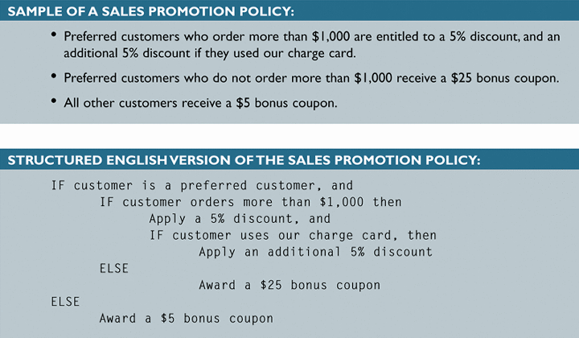
Structured English - Example
SE might look familiar to programming students because it resembles pseudocode

Slide 16
Pros and Cons of SE
Pros
Cons
Independent of any particular programming language
Easy to learn
Used in most CASE tools
No graphical tool required - can be word processed
Concise, precise and readable to users and programmers
Data dictionary entries are used to identify all variable, files and tables - ensures consistency and integrity
Exact form of SE to be used must be detailed in Standards document
Use of SE does NOT guarantee correctness
Large block of SE can appear daunting to system users and may need explaining
Notes:
Compound sentences are discouraged as they frequently create ambiguity
Use strong action verbs : GET, FIND, CREATE, ADD, DELETE, SORT etc

Slide 17
2. DECISION TABLE
A decision table is a logical structure that shows every combination of conditions and outcomes / actions.
Analysts often use decision tables to describe a process and ensure that they have considered all possible situations.
You can create decision tables using Microsoft PowerPoint, Word, or Excel.

Slide 18
Decision Tables
Decision table is a tabular representation of multiple decision points
Table has four quadrants:
Conditions stub | Conditions entries
Actions stub | Actions entries
Notes:
Good for modelling complex decision logic

Slide 19
How to Create a Decision Table (cont.)
1. Identify Conditions
3. Calculate number of rules
2. Identify Actions
= 2^{Number of conditions}
= 2³ = 8 rules
Conditions Correct dimensions? Passed mechanical test? Passed electrical test? | Conditions entries * If conditions are met put “Y”, * If conditions are not met put “N”
Actions Accept product Repair product Reject product | Actions entry * Put “X” if the action applies, and leave blank if actions does not apply.
Notes:
N=number of conditions

Slide 20
Useful Videos
https://www.youtube.com/watch?v=aryLIJvvp7I&feature=youtu.be
Uses a combination of patterns for rules (refer table below)
Outcome depends on scenario
* For outcomes (actions entries), we will use “X” for the actions that applies (not Y or N, as this video shows – different authors uses slightly different notations)
2 conditions | 1 | 2 | 3 | 4
1st cond | Y | Y | N | N
2nd cond | Y | N | Y | N
3 conditions | 1 | 2 | 3 | 4 | 5 | 6 | 7 | 8
1st cond | Y | Y | Y | Y | N | N | N | N
2nd cond | Y | Y | N | N | Y | Y | N | N
3rd cond | Y | N | Y | N | Y | N | Y | N

Slide 21
Decision Table - Conditions
TABLES WITH ONE CONDITION
If a process has a single condition, there only are two possibilities – yes or no.
Either the condition is present or it is not, so there are only two rules.
For example, to trigger an overtime calculation, the process condition might be: Are the hours greater than 40? If so, the calculation is made. Otherwise, it is not.
TABLES WITH TWO CONDITIONS
Suppose you want to create a decision table based on the Verify Order business process.
When documenting a process, it is important to ensure that you list every possibility.
In this example, the process description contains two conditions: product stock status and customer credit status.
If both conditions are met, the order is accepted. Otherwise the order is rejected.

Slide 22

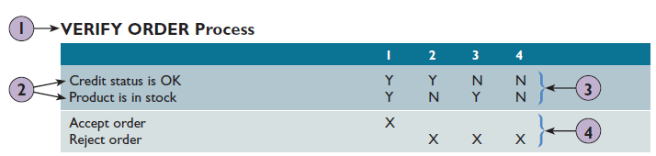
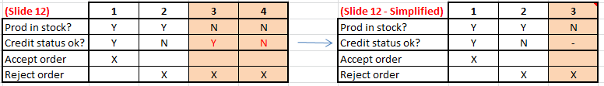
Steps to create a Decision Table
Place the name of the process in the heading at the top left.
Enter the conditions under the heading, with one condition per line. The determinant condition should be on top for easy understanding
Enter all the potential combinations of yes and no (Y/N) for the conditions. Each column represents a numbered possibility called a rule. Read each rule downwards.
Place an X in the action entries area for each rule to indicate what actions to take.
Better to put “Product is in stock” as first condition, as it is a determinant condition (as long as there is no stock, there is no need to bother about credit status).
Notes:
The example from a textbook is ok but it is better to put “Product is in stock” as first condition, as it is a determinant condition (as long as there is no stock, there is no need to bother about credit status).
Example: If you want to buy a product, the salesperson will check if product is in stock first, then only check if your credit status is ok. It will be funny (discriminating) if the salesperson ask you your credit status first (to see if you got money) then only check if got stock.
(Note: The pic overlapping is my version)

Slide 23
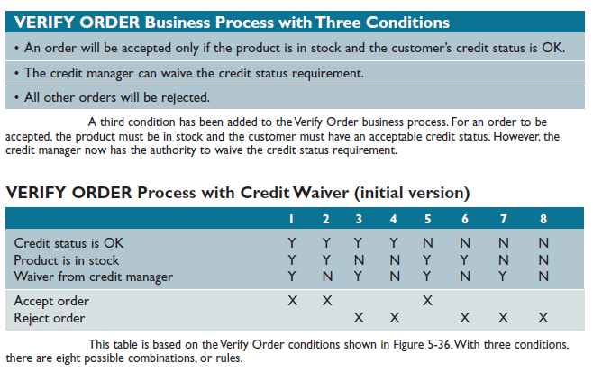
Decision Table – THREE CONDITIONS Example

Slide 24
Simplifying the Decision Table
When all the outcomes have been determined, you are ready to simplify the table.
In a multi-condition table, some rules might be duplicates, redundant, or unrealistic.
To simplify the table, follow these steps:
1. Study each combination of conditions and outcomes. When you have rules with three conditions, only one or two of them may control the outcome, and the other conditions simply do not matter.
2. If you identify conditions that do not affect the outcome, mark them with dashes (-)
3. Now combine and renumber the rules
Tips: you can also look at the actions/outcome part. If the outcome is the same, then check if any of the condition is redundant/irrelevant

Slide 25
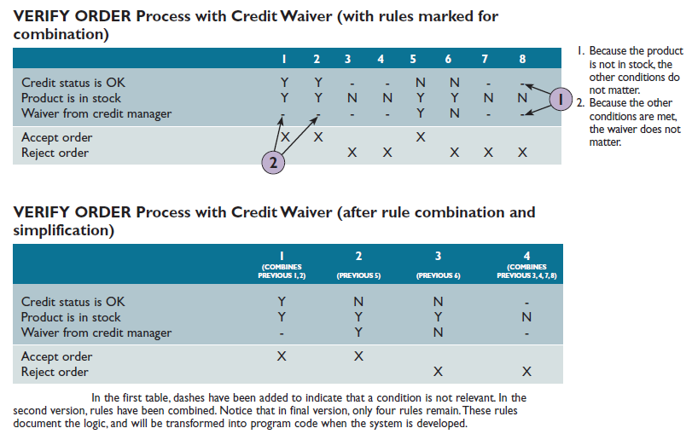
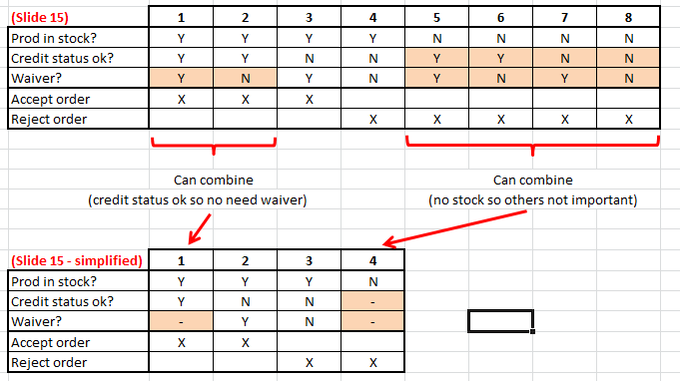
Simplifying the Decision Table - Three Conditions Example
If you follow these steps, you will see that Rules 1 and 2 can be combined because
credit status is OK in both rules, so the waiver would not matter. Rules 3, 4, 7, and 8
also can be combined because the product is not in stock, so other conditions do not
matter. The result is that instead of eight possibilities, only four logical rules control the
Verify Order process.
Notes:
This Example, is better to put the “Product is in stock” as first condition (for easy viewing & understanding).
If Credit status is ok, it doesn’t matter if waiver, the order will still be excepted.
If Product is not in stock, it doesn’t matter whether the credit status is ok or whether it is waivered.
(Note: The pic overlapping is my version)

Slide 26
Read each rule downwards. The determinant condition, should be on top for easy understanding/reading.
Decision Table
Conditions/Actions | 1 | 2 | 3 | 4 | 5 | 6 | 7 | 8
Correct dimensions? | Y | Y | Y | Y | N | N | N | N
Passed mechanical test? | Y | Y | N | N | Y | Y | N | N
Passed electrical test? | Y | N | Y | N | Y | N | Y | N
Accept product | X
Repair product |  | X | X
Reject product |  |  |  | X | X | X | X | X
Can you see redundancy?
Showing all pattern-action rules is NOT efficient. If answer to the first Condition “Correct Dimensions?” is “N”, then the other 2 conditions are irrelevant. We can simplify the Decision Table by combining them and putting a “-” for those that are irrelevant (refer next slide).
Notes:
N=number of conditions

Slide 27
Decision Table (Simplified)
 | 1 | 2 | 3 | 4 | 5
Correct dimensions? | Y | Y | Y | Y | N
Passed mechanical test? | Y | Y | N | N | -
Passed electrical test? | Y | N | Y | N | -
Accept product | X
Repair product |  | X | X
Reject product |  |  |  | X | X
Combined rules 5-8:
As long as the dimensions are incorrect, it doesn’t matter if it pass or fail mechanical or electrical tests, so can just put “-”.
Adapted from Lejk & Deeks (2002), pp 103.

Slide 28
Example: Decision Table
 | 1 | 2 | 3 | 4 | 5 | 6 | 7 | 8
Regular cust? | Y | Y | Y | Y | N | N | N | N
Order 0-99? | Y | Y | N | N | Y | Y | N | N
Order 100-500? | - | - | Y | N | - | - | Y | N
No discount | X | X |  |  | X | X
Discount 10% |  |  |  |  |  |  | X
Discount 15% |  |  | X |  |  |  |  | X
Discount 20% |  |  |  | X
Free Gift |  |  |  | X |  |  |  | X

Slide 29
Example: Decision Table (Simplified)
 | 1 | 2 | 3 | 4 | 5 | 6
Regular cust? | Y | Y | Y | N | N | N
Order 0-99? | Y | N | N | Y | N | N
Order 100-500? | - | Y | N | - | Y | N
No discount | X |  |  | X
Discount 10% |  |  |  |  | X
Discount 15% |  | X |  |  |  | X
Discount 20% |  |  | X
Free Gift |  |  | X |  |  | X

Slide 30
Decision Table: Variations
Regular customer? | Y | Y | Y | N | N | N
Order value (£) | 0-99 | 100-500 | >500 | 0-99 | 100-500 | >500
Discount given | 0 | 15% | 20% | 0 | 10% | 15%
Free gift |  |  | X |  |  | X
Adapted from Lejk & Deeks (2002), pp 105.
Notes:
If answer to first question is N then others irrelevant

Slide 31
Multiple Outcomes
In addition to multiple conditions, decision tables can have more than two possible outcomes.
For example, the sales promotion policy shown in the next slide includes three conditions:
Was the customer a preferred customer,
did the customer order $1,000 or more, and
did the customer use our company charge card?
Based on these conditions, four possible actions can occur, as shown in the decision table in the next slide.

Slide 32
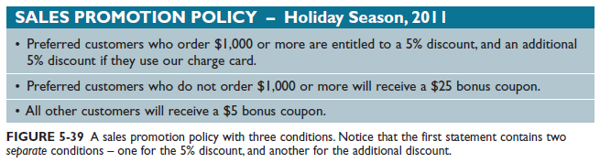
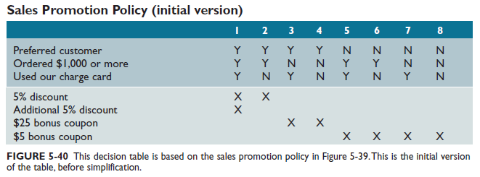
Sales Promotion Policy (initial version) - Example

Slide 33
Sales Promotion Policy (initial version) - Example (Explanation)
When you study the conditions and outcomes, you realize that:
• In Rule 1, all three conditions are met, so both 5% discounts apply.
• In Rule 2, a preferred customer orders $1,000 or more, but does not use our charge card, so only one 5% discount applies.
• Rules 3 and 4 can be combined into a single rule. Why? If preferred customers do not order $1,000 or more, it does not matter whether they use our charge card – either way, they only earn a $25 bonus coupon. Therefore, Rules 3 and 4 really are a single rule.
• Rules 5, 6, 7, and 8 also can be combined into a single rule – because if the person is not a preferred customer, he or she can only receive a $5 bonus coupon, and the other conditions simply do not matter. So, you insert a dash if a condition is irrelevant, as shown in Figure 5-41.
If you add dashes for rules that are not relevant, your table should resemble the one shown in Figure 5-41.
When you combine and simplify the results, only four rules remain: Rule 1, Rule 2, Rule 3 (a combination of initial Rules 3 and 4), and Rule 4 (a combination of initial Rules 5, 6, 7, and 8).
Decision tables often are the best way to describe a complex set of conditions.
Many analysts use decision tables because they are easy to construct and understand, and programmers find it easy to work from a decision table when developing code.

Slide 34
Steps to create a Decision Table
Place the name of the process in the heading at the top left.
Enter the conditions under the heading, with one condition per line.
Enter all the potential combinations of yes and no (Y/N) for the conditions. Each column represents a numbered possibility called a rule.
Place an X in the action entries area for each rule to indicate what actions to take.

Slide 35
Decision Table – Three Conditions Example

Slide 36
Simplifying the Decision Table
When all the outcomes have been determined, you are ready to simplify the table.
In a multi-condition table, some rules might be duplicates, redundant, or unrealistic.
To simplify the table, follow these steps:
1. Study each combination of conditions and outcomes. When you have rules with three conditions, only one or two of them may control the outcome, and the other conditions simply do not matter.
2. If you identify conditions that do not affect the outcome, mark them with dashes (-)
3. Now combine and renumber the rules

Slide 37
Simplifying the Decision Table - Three Conditions Example
If you follow these steps, you will see that Rules 1 and 2 can be combined because
credit status is OK in both rules, so the waiver would not matter. Rules 3, 4, 7, and 8
also can be combined because the product is not in stock, so other conditions do not
matter. The result is that instead of eight possibilities, only four logical rules control the
Verify Order process.

Slide 38
3. DECISION TREE
A decision tree is a graphical representation of the conditions, actions, and rules found in a decision table. It is a graphical representation of a decision situation.
Decision trees show the logic structure in a horizontal form that resembles a tree with the roots at the left and the branches to the right.
Like flowcharts, decision trees are useful ways to present the system to management.

Slide 39
Logic Modelling using Decision Trees
Decision trees and decision tables provide the same results, but in different forms.
In many situations, a graphic is the most effective means of communication.
A decision tree is read from left to right, with the conditions along the various branches and the actions at the far right.
Like a decision table, a decision tree shows all combinations of conditions and outcomes. The main difference is the graphical format, which many viewers find easier to interpret.

Slide 40
Decision Trees
A graphical representation of a decision situation
Decision situation points are connected together by arcs/nodes and terminate in ovals
Two main components:
Decision points represented by arcs/nodes
Actions represented by ovals

Slide 41
Read from left to right
Decision Tree
2 Choices per Decision Point
We will use this notation!
1
No
Reject product
Yes
Actions (represented by ovals)
All possible actions are listed on the far right.
Conditions/ Decision Points (represented by archs/nodes)
Each node corresponds to a numbered choice on a legend.
No
3
No
Reject product
2
Yes
Yes
Repair product
3
No
Legend
Dimensions ok?
Pass mechanical test?
Pass electrical test?
Yes
Repair product
Pass product
* Remember to include legend.
Notes:
There are many ways to draw a Decision Tree. We will follow this notations.
Read from left to right
Each node corresponds to a numbered choice on a legend
All possible actions are listed on the far right

Slide 42
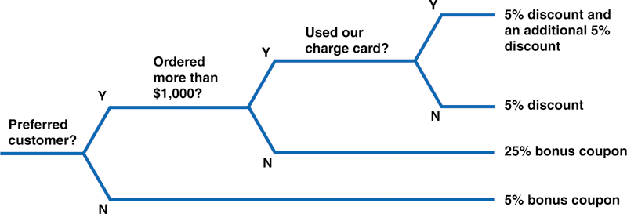
Decision Trees - Sales Promotion Policy Example
This example is based on the same Sales Promotion Policy shown in the decision tables in Figures 5-40 and 5-41 on the previous slides.

Slide 43
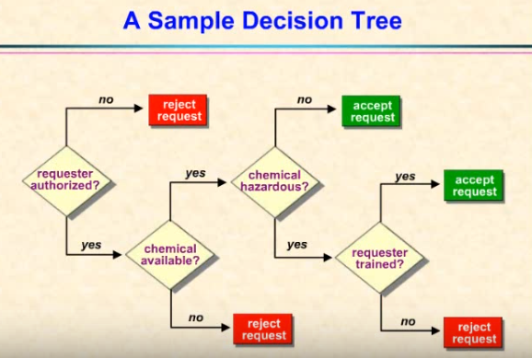
Decision Tables and Decision Trees
https://www.youtube.com/watch?v=Yl463_pRvbw
Shows how a scenario can be drawn in Decision Table and Decision Tree.
Student Activity:
Pause video at 4:00 minutes. Draw the Decision Tree based on the notations on slide 6.

Slide 44
Compare the different Logic Modelling techniques
Now let’s look at how the 3 different Logic Models (Structured English, Decision Table, and Decision Tree) can be used for a scenario.
Scenario:
Employees can either be a Full Time employee or a Part Time employee. For Full Time employees, the company will pay the base salary. For Part Time employees, they are required to work at least 40 hours per month. If they worked less than 40 hours, then the company will pay hourly wage and produce absence report. If they worked 40 hours, then the company will pay hourly wage. If they worked more than 40 hours, then the company will pay hourly wage and pay overtime wage.
Construct a Structured English, Decision Table, and Decision Tree for the above scenario (without looking at the answers).

Slide 45
Example - SE Version (Salary)
If Full Time employee then
Pay base salary
else
If Hours worked < 40 then
Pay hourly wage
Absence report
else
If Hours worked =40 then
Pay hourly wage
else
Pay hourly wage
Pay overtime wage
End If (optional)

Slide 46
Example - Decision Table (Salary)
 | Conditions / Course of Action | Rules
 |  | 1 | 2 | 3 | 4
Condition | Full Time? | Y | N | N | N
 | Hours Worked < 40? | - | Y | N | N
 | Hours Worked = 40? | - | - | Y | N
Action | Pay base salary | X
 | Calculate Hourly Wage |  | X | X | X
 | Calculate Overtime |  |  |  | X
 | Produce Absence Report |  | X
Notes:
Note:
Hours work can either be <40, =40 or >40. So if it is NOT <40 and NOT =40, it has to be >40, so we don’t have to put a row for condition >40.
For Full Time, it doesn’t matter on the hours worked, as they will have to work at a fixed time. Hours worked are more for Part Timers.

Slide 47
Example - Decision Table Variation (Salary)
 | Conditions / Course of Action | Rules
 |  | 1 | 2 | 3 | 4
Condition | Employee Type | Full Time | Part Time | Part Time | Part Time
 | Hours Worked | - | < 40 | 40 | > 40
Action | Pay base salary | X
 | Calculate Hourly Wage |  | X | X | X
 | Calculate Overtime |  |  |  | X
 | Produce Absence Report |  | X

Slide 48
Example - Decision Tree (Salary)
2 Choices per Decision Point
1
Yes
Pay base salary
No
Pay hourly wage;
Yes
Absence report
2
No
3
Yes
Pay hourly wage
No
Legend
Full Time?
Hours Worked < 40?
Hours Worked = 40?
Pay hourly wage;
Pay overtime wage
Note the two main components:
Decision points represented by arcs/nodes
Actions represented by ovals
Each node corresponds to a numbered choice on a legend
See : Hoffer, J. A., George, J. F., and Valacich, J. S. (2001). Modern Systems Analysis and Design. 3rd Edition, PP 292, Prentice-Hall International,.

Slide 49
Decision Table or Decision Tree?
Whether to use a decision table or a decision tree often is a matter of personal preference.
A decision table might be a better way to handle complex combinations of conditions.
On the other hand, a decision tree is an effective way to describe a relatively simple process.

Slide 50
Summary
Each functional primitive process is documented using structured English, decision tables, and decision trees.
Structured English uses a subset of standard English that defines each process with combinations of the basic building blocks of sequence, selection, and iteration.
You also can document the logic by using decision tables or decision trees.

Slide 51


